Slide 1
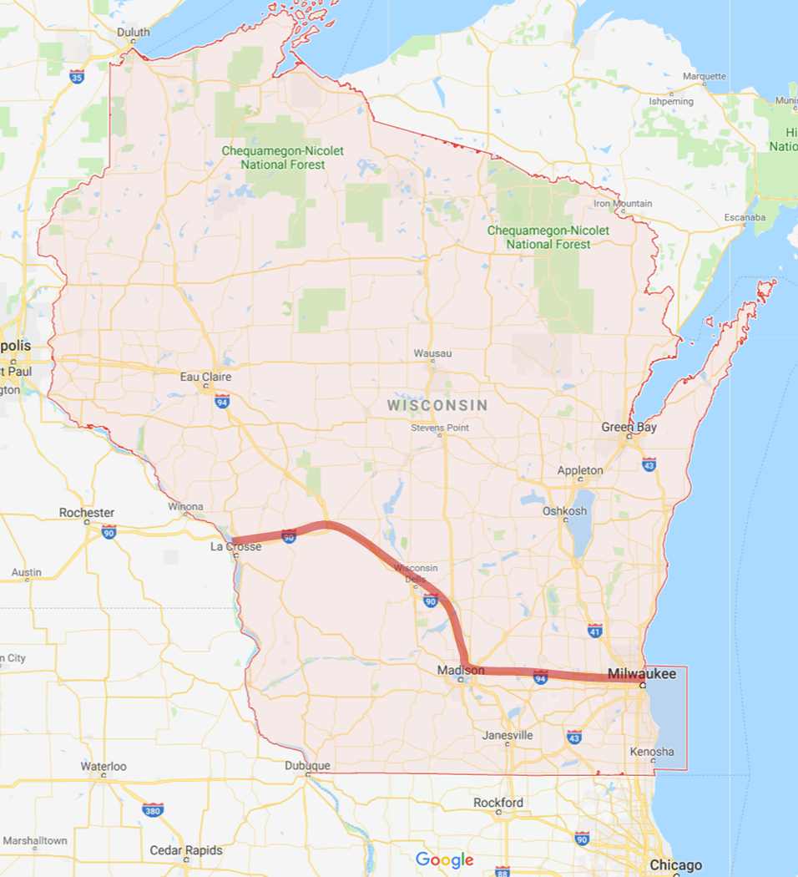
The use of most chlorimuron-ethyl based herbicides is typically limited to fields south of I-90 between Lacrosse and Madison and fields south of I-94 between Madison and Milwaukee (Map from Google Maps)

